Slide 1


PDF analysis of nanostructured materials
S.J.L. Billinge
Department of Applied Physics and Applied Mathematics
Columbia University,
CMPMS, Brookhaven National Laboratory

Slide 2
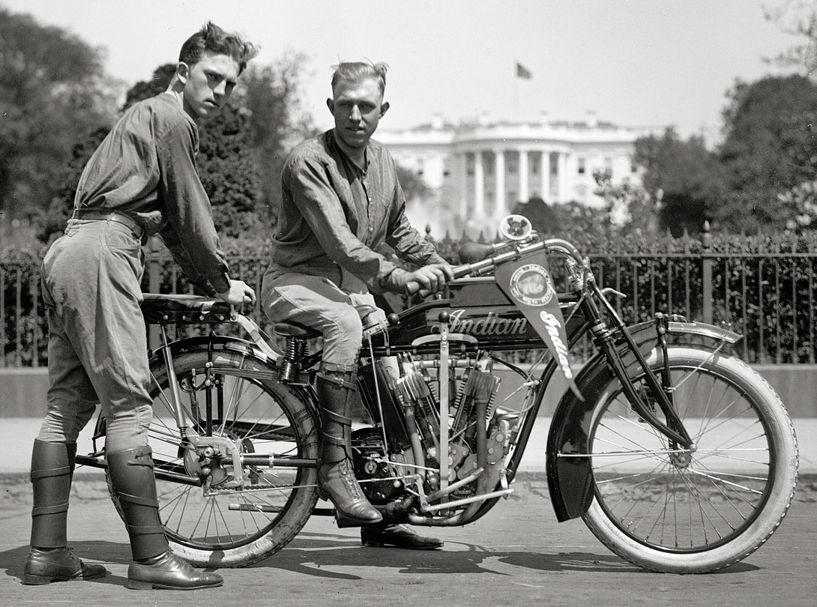
Materials in 1915
cotton
brylcreem
steel
wool
rubber
leather

Slide 3
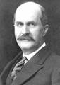
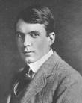
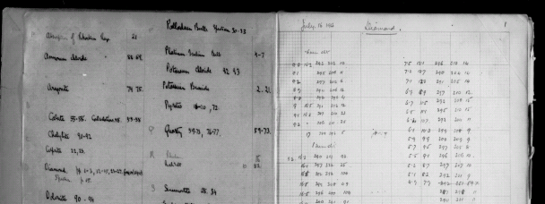
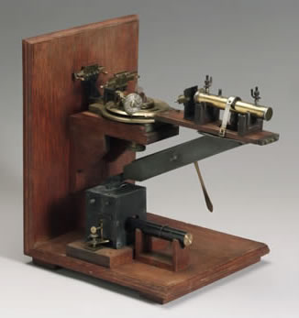
W. Henry Bragg’s notebook
paper
wood
brass
Available at U. Leeds website:
http://www.leeds.ac.uk/library/spcoll/bragg-notebook/

Slide 4
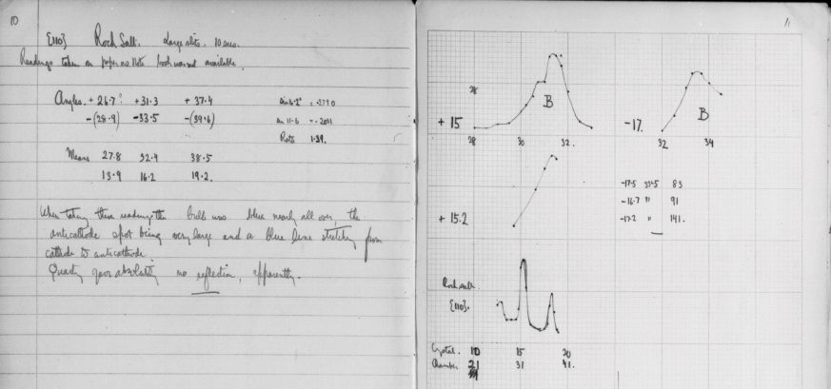
Big data, circa 1915
Page 11, he has moved from diamond to rock-salt….the first appearance of something looking like a Bragg peak

Slide 5
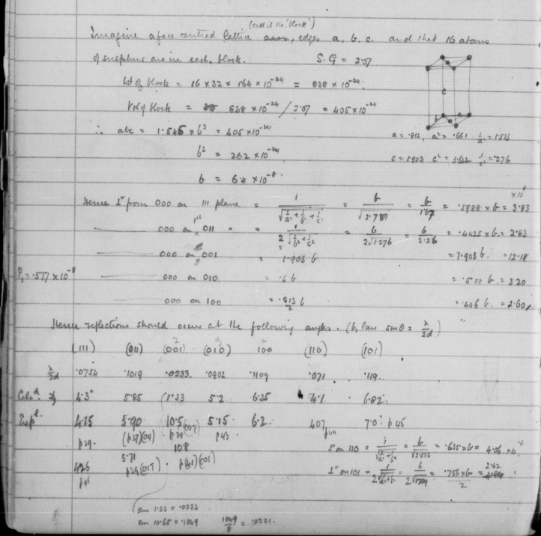
HPC circa 1915
Apparently the first structure solution
Page 43

Slide 6
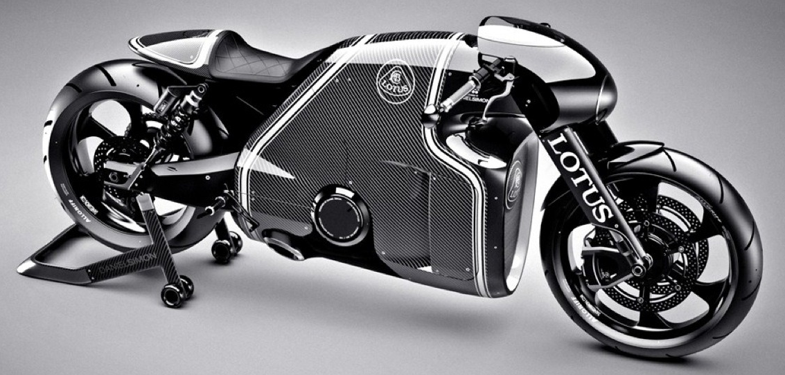
Materials 2015
synthetic
synthetic
synthetic
synthetic

Slide 7
Page 11, he has moved from diamond to rock-salt….the first appearance of something looking like a Bragg peak

Slide 8
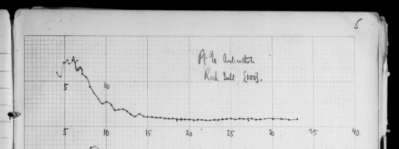
Diffuse Scattering
The Braggs discovered Bragg scattering on Page 11
But apparently they discovered diffuse scattering on Page 5!

Slide 9
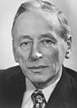
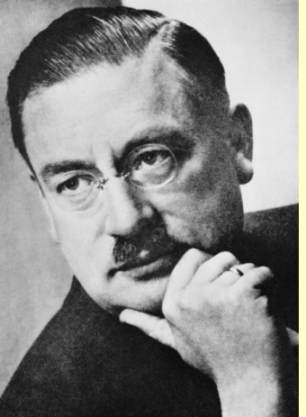
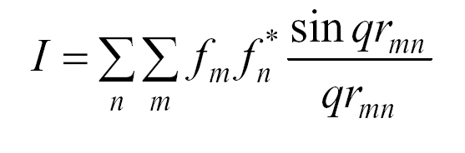
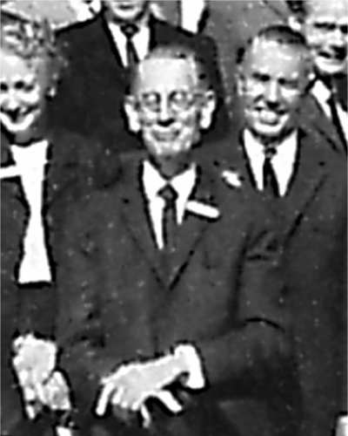
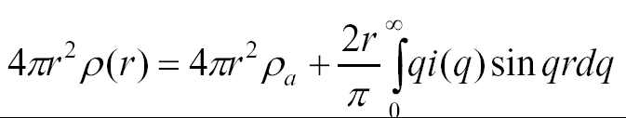
Computational issues: A Brief History of PDF
Pieter Debye, 1915:
Fritz Zernike and Jon Prins, 1927:

Slide 10
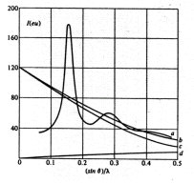
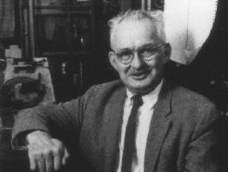
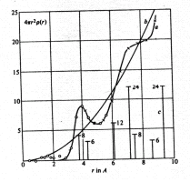
History
Debye and Menke, Z. Phys. (1930)
PDFs of mercury
Tarasov, L. P., and Warren, B. E., (1936) J. Chem. Phys., 4, 236.
X-ray PDFs of molten sodium

Slide 11
More History
1930s-1980s
lots of low resolution work on liquids and glasses
Notable work by Rosalind Franklin on disordered carbons in the 1950’s right before she did the x-ray work for the discovery of the double-helix
1980’s =>
first dedicated synchrotron sources (more flux at higher energies, 30 keV)
First spallation pulsed neutron sources (undermoderated so more epithermal neutrons)
1990’s =>
First meaningful PDFs on well ordered materials
Quantitative structural modeling
2000’s =>
2D detectors (RaPDF)
Good computing

Slide 12
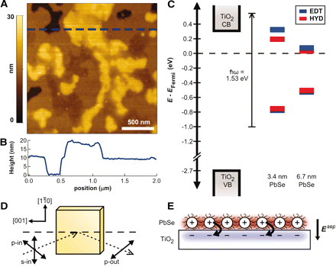
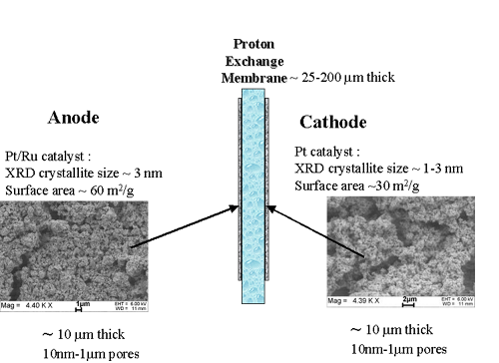
Complex materials
Photovoltaics with improved efficiency
Nanoparticles in the light collecting layer
High energy density batteries
Electrodes
Electrolytes
Fuel cells for transportation applications
Electrodes
Electrolytes
Catalysts
Hydrogen storage
Sequestration
Functionalized mesoporous materials
Image credits: 10.1126/science.1185509
U. Uppsala

Slide 13
The Nanostructure Problem
We want to engineer materials at the nanoscale
But we can’t even solve the atomic structure at the nanoscale:
The nanostructure problem

Slide 14
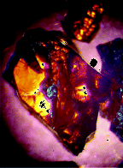
The Crystal Structure Problem
Problem:
Here is a crystal, what is its structure?
Solution:
Give it to your grad student
She puts it on the x-ray machine
…Pushes the button
Machine tells you the structure
Or Machine gets stuck
Throw away the crystal
Make it the subject of her thesis
Crystallography is largely a solved problem
From LiGaTe2: A New Highly Nonlinear Chalcopyrite Optical Crystal for the Mid-IR L. Isaenko, et al., J. Crystal Growth, 5, 1325 – 1329 (2005)

Slide 15
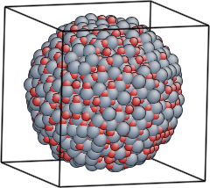
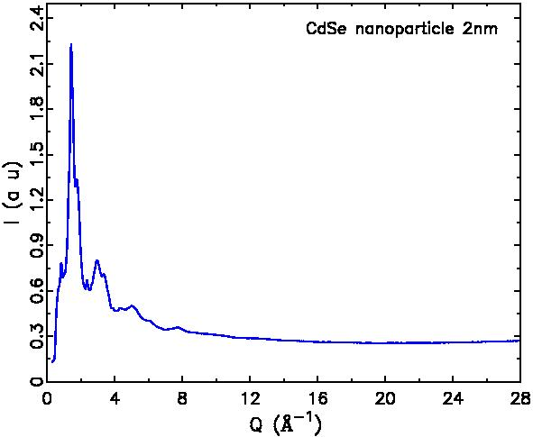
The Nanostructure Problem
Problem:
Here is a nanoparticle, what is its structure?
Solution:
Give it to your grad student
She puts it on the x-ray machine
…Pushes the button

Slide 16
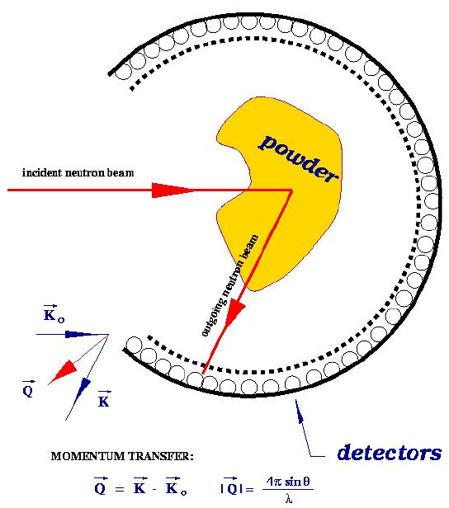
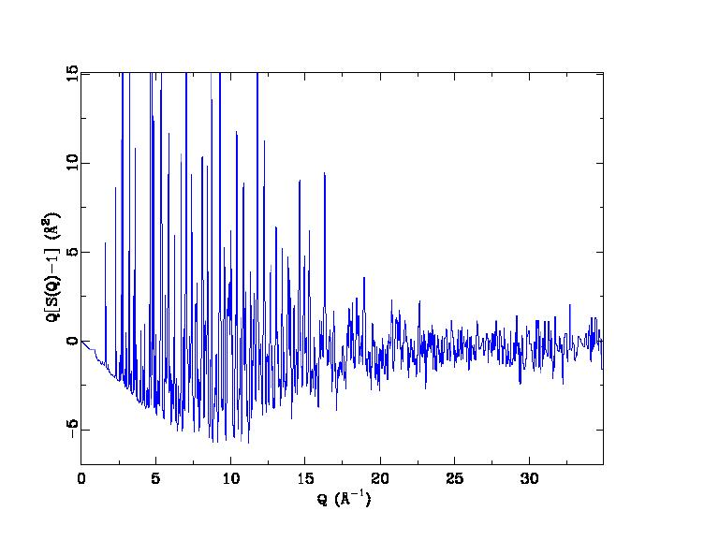
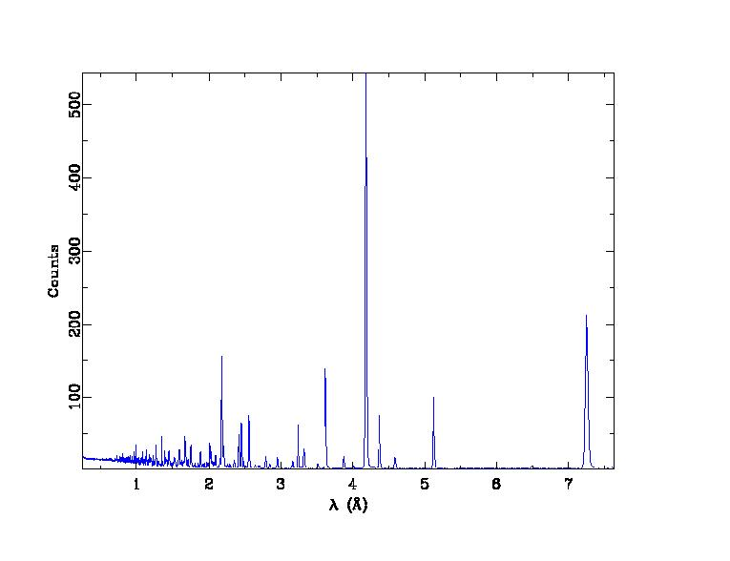
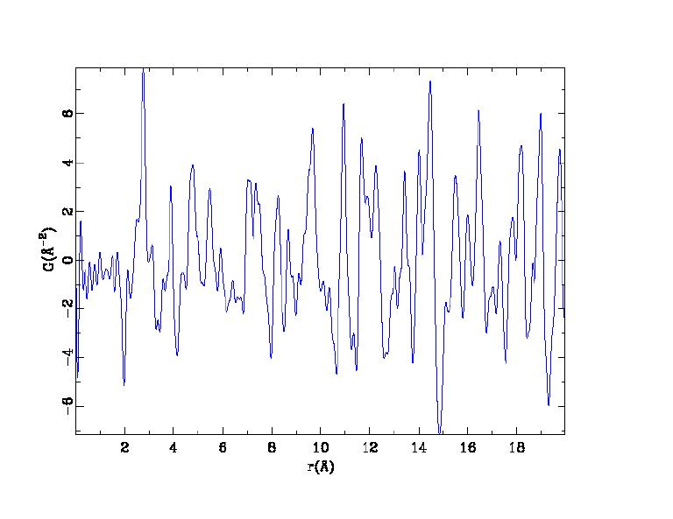
The atomic Pair Distribution Function
Structure function
Raw data
PDF

Slide 17
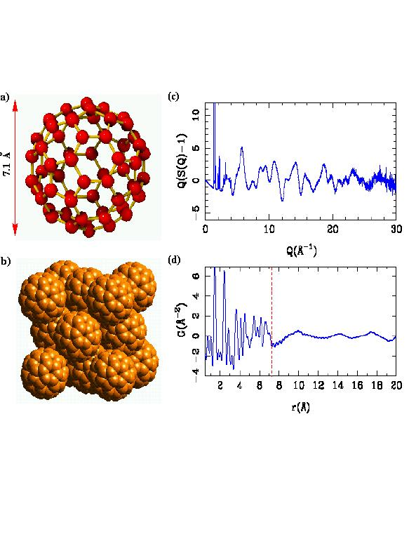
What is the PDF?
Sit on an atom and look at your neighborhood
G(r) gives the probability of finding a neighbor at a distance r
PDF is experimentally accessible
PDF gives the local structure

Slide 18
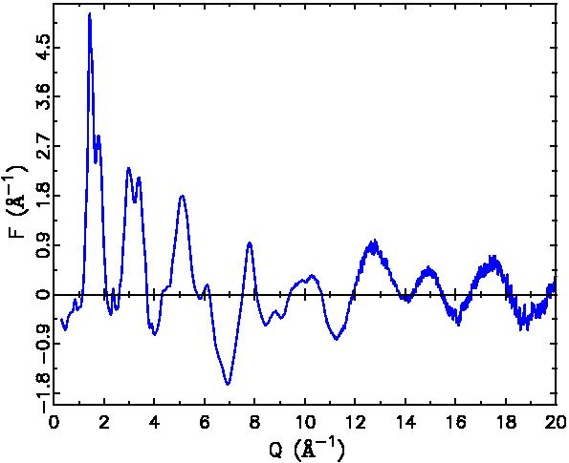
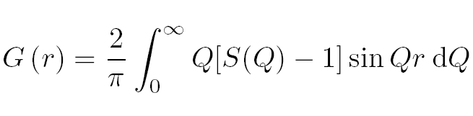
But there is no information at high-Q…?
<f(Q)>²

Slide 19
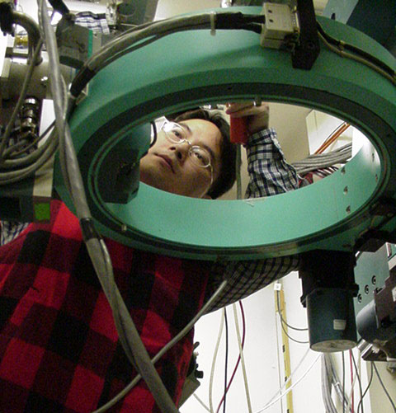
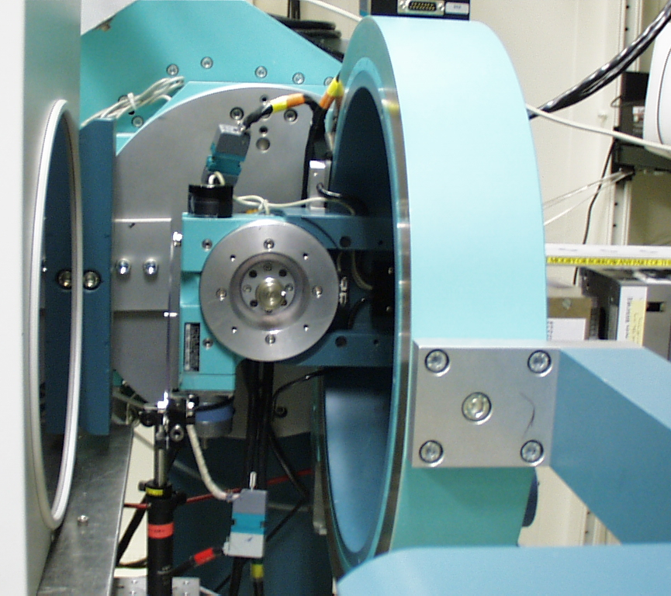
The Atomic Pair Distribution Function (PDF) Method
Use modern high intensity x-ray and neutron sources to collect unprecedentedly precise data
Utilize all the information: Bragg and diffuse scattering
Use modern computing capabilities to analyze, model and visualize the data
Chupas et al., J. Appl. Crystallogr. (2003)
Billinge-group, BNL, SUNY-SB, APS collaboration
Main developments thanks to Pete Chupas and Xiangyun Qiu

Slide 20
Synchrotron beamlines for PDF work
NSLS-II @ Brookhaven National Laboratory
XPD
PDF
APS @ Argonne National Laboratory
11IDB, 11IDC
CHESS
A2
ESRF
ID15, ID11, ID22
Spring 8
various
DESY
P07, P2.1
Diamond
XPDF

Slide 21
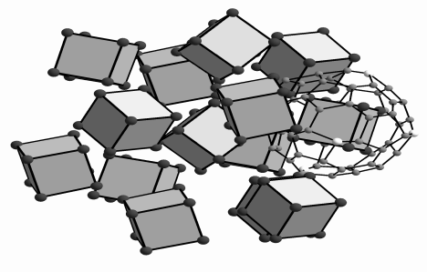
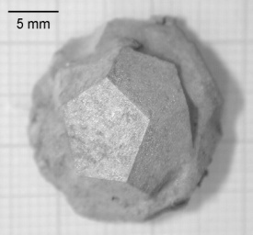
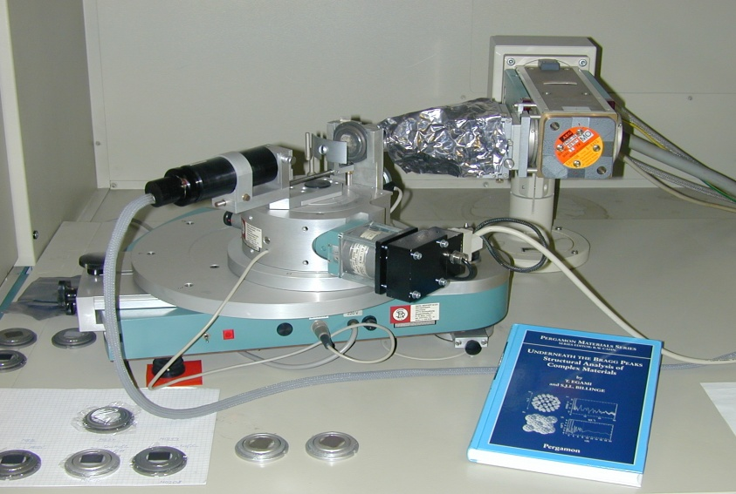
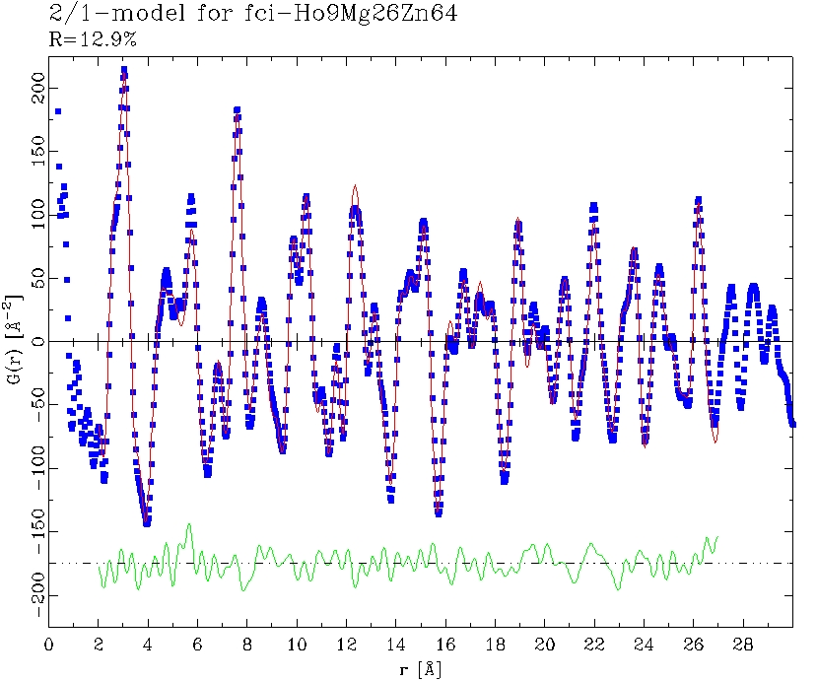
X-ray PDF: In-house measurements
Huber Gunier diffractometer
Q_{max} = 13.5Å⁻¹
fci-Ho-Mg-Zn
Brühne et al., Z. Kristallogr. 219 (2004) 245-258

Slide 22
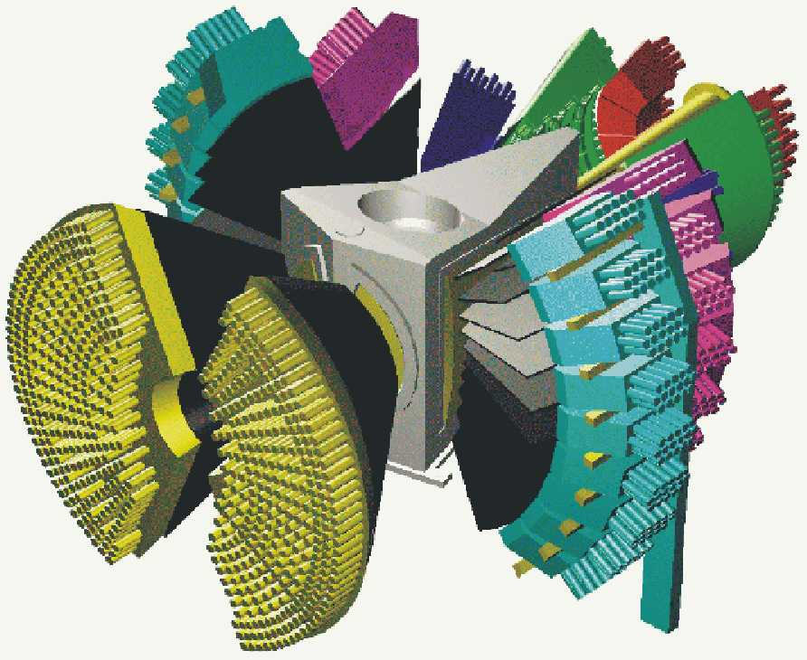
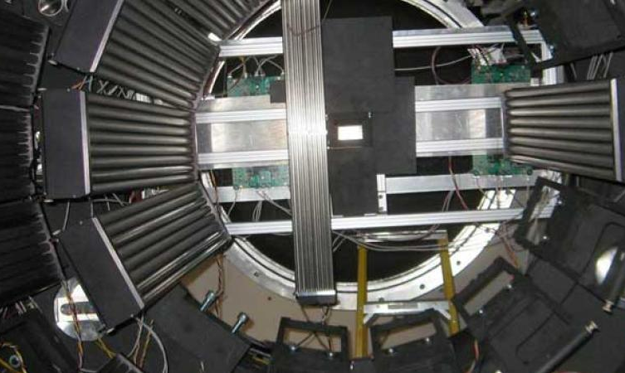
RAPDF with Neutrons
GEM, POLARIS & NIMROD @ISIS
POWGEN3 & NOMAD @SNS
D4 @ILL

Slide 23

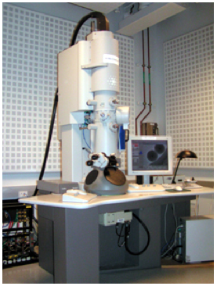
PDFs from laboratory microscopes

Slide 24
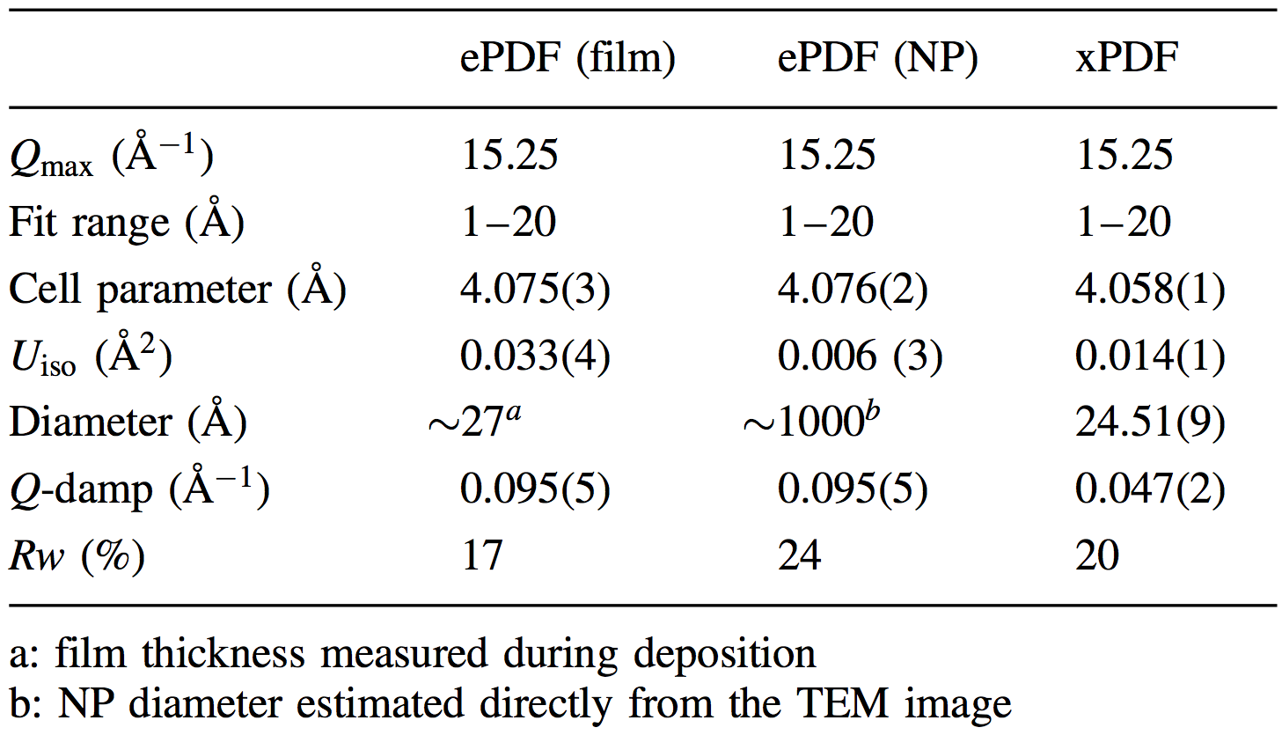
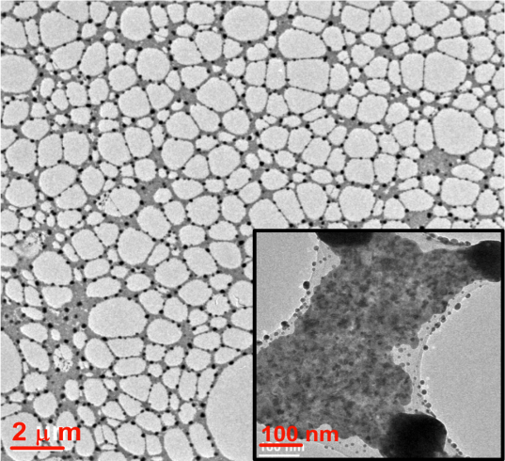
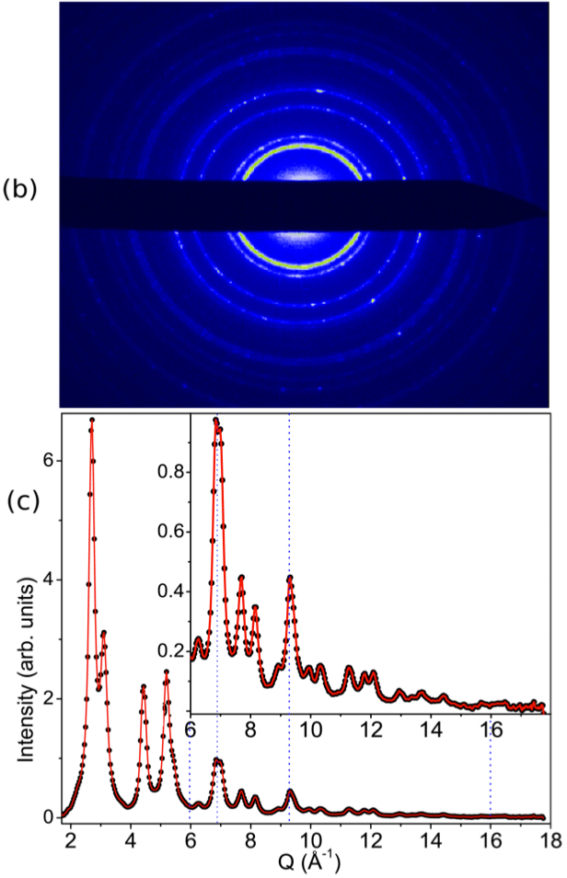
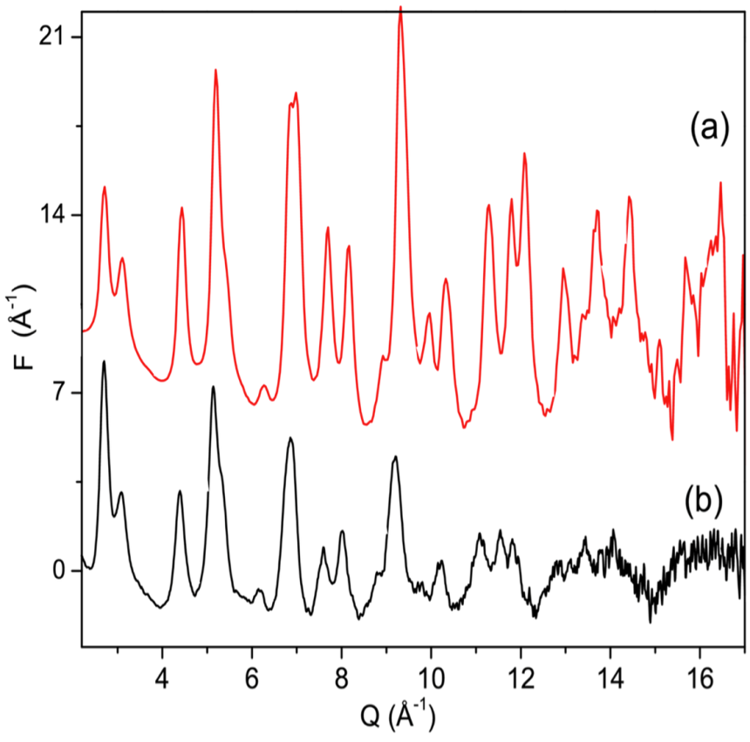
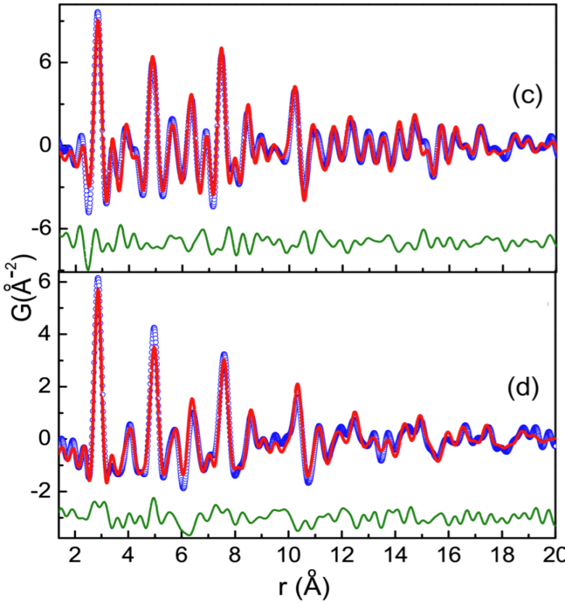
Au (1000) Å particles
ePDFsuite software. Ask for details
ePDF
xPDF

Slide 25
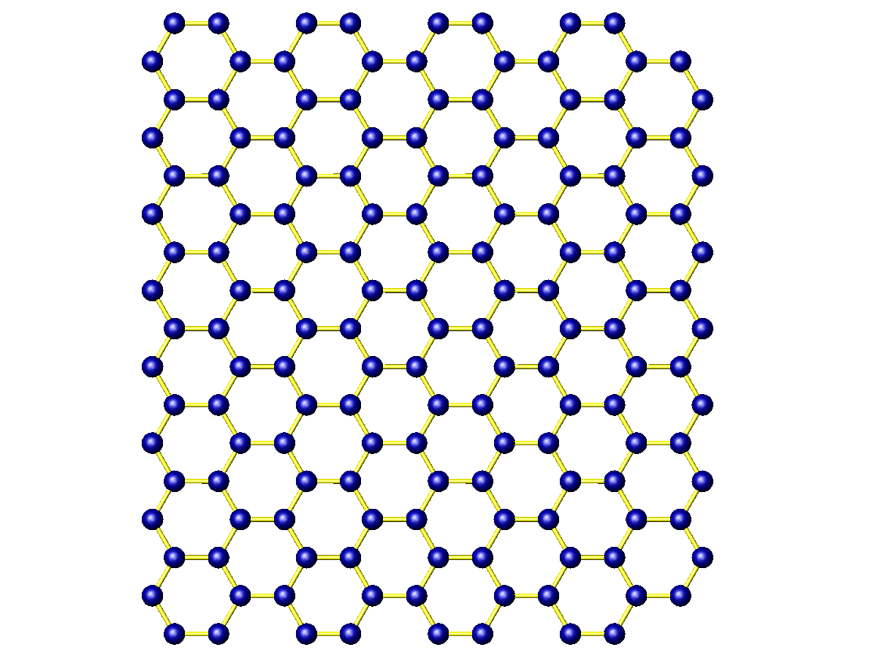
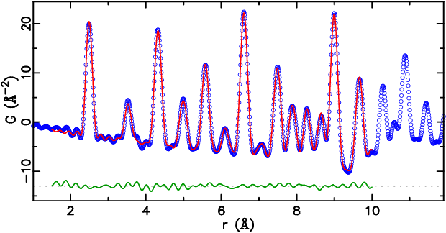
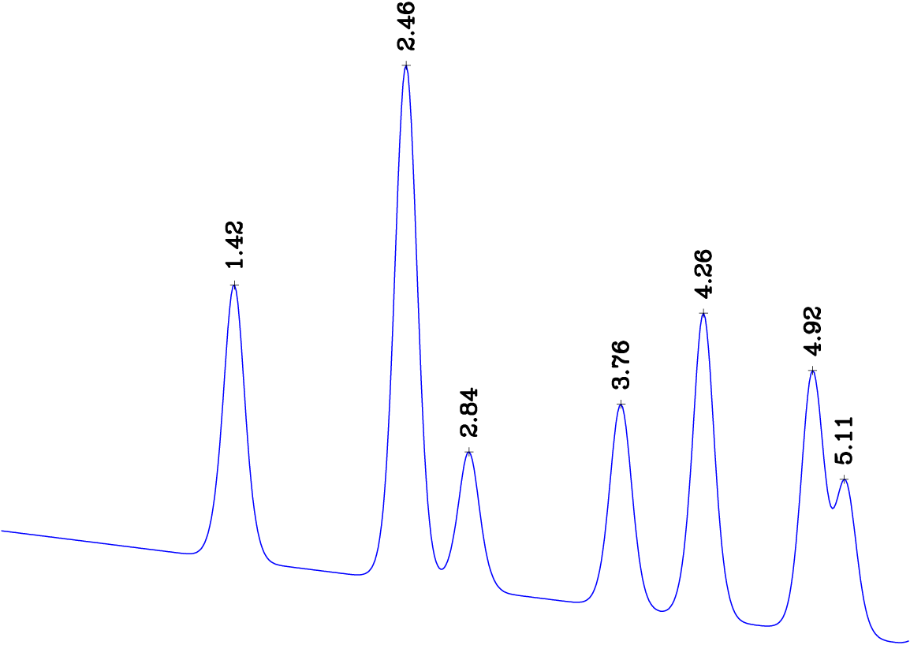
Nanostructure refinement
4.26Å
Pair distribution function (PDF) gives the probability of finding an atom at a distance “r” from a given atom.
2.84Å
1.42Å
2.46Å
3.76Å
4.92Å
5.11Å
5

Slide 26
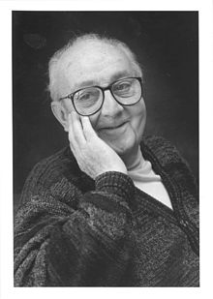
Modeling summary
Small Box modeling
Similar in nature to Rietveld refinement of powder diffraction data
Small number of parameters, highly constrained fits
Danger of model bias, difficult to find distorted solutions.
Exemplars: PDFgui
Large Box modeling
Large number of atoms in a box allowed to move around to get good fits
Small number of constraints, exploratory unbiased fitting. Good at finding distorted solutions
Danger of overfitting and degenerate solutions. Difficult to assess uncertainties
Exemplars: RMCprofile, RMC and Diffev in DISCUS, EPSR (hybrid method)
George Box modeling
All models are wrong; some models are useful.
George E. P. Box, William Hunter and Stuart Hunter, Statistics for Experimenters, second edition, 2005, page 440.

Slide 27
PDFgui
Used to be called “real-space Rietveld”
Starting point is a crystallographic description of the model
Small Unit cell, periodic boundary conditions
Fits to G(r) which is the FT of F(Q)
PDFgui
Available from diffpy.org
Development funded by NSF-DANSE program

Slide 28
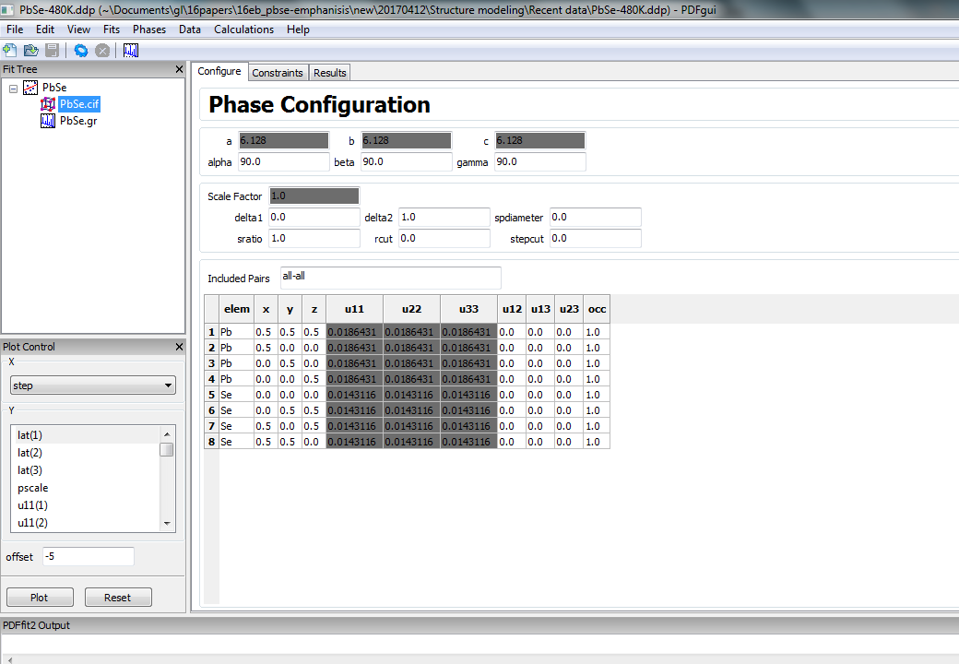

Slide 29
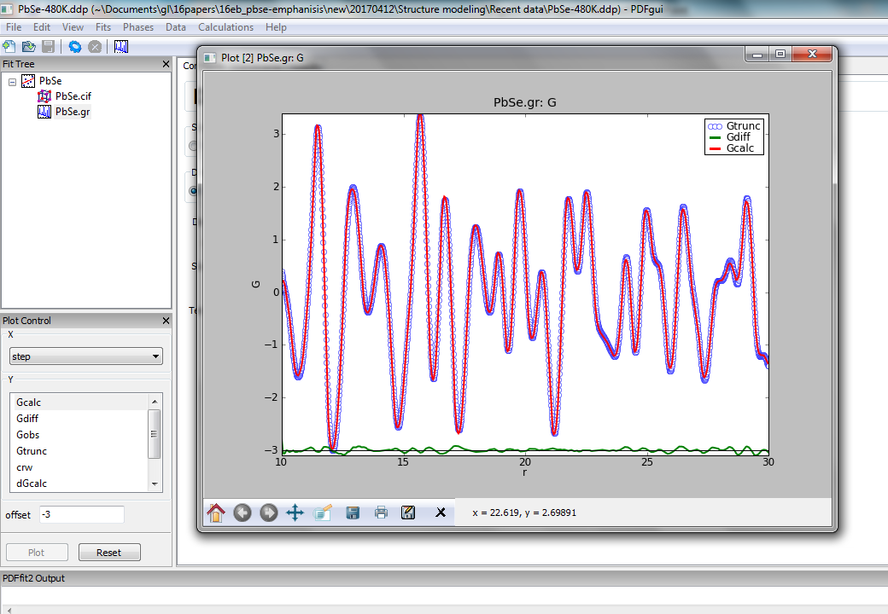

Slide 30
CMI: complex modeling infrastructure
CMI
Also available at diffpy.org
Very powerful
Very difficult to use
We are working on a more friendly user interface and better documentation, but for now it is advised to contact us and we can help you get started

Slide 31

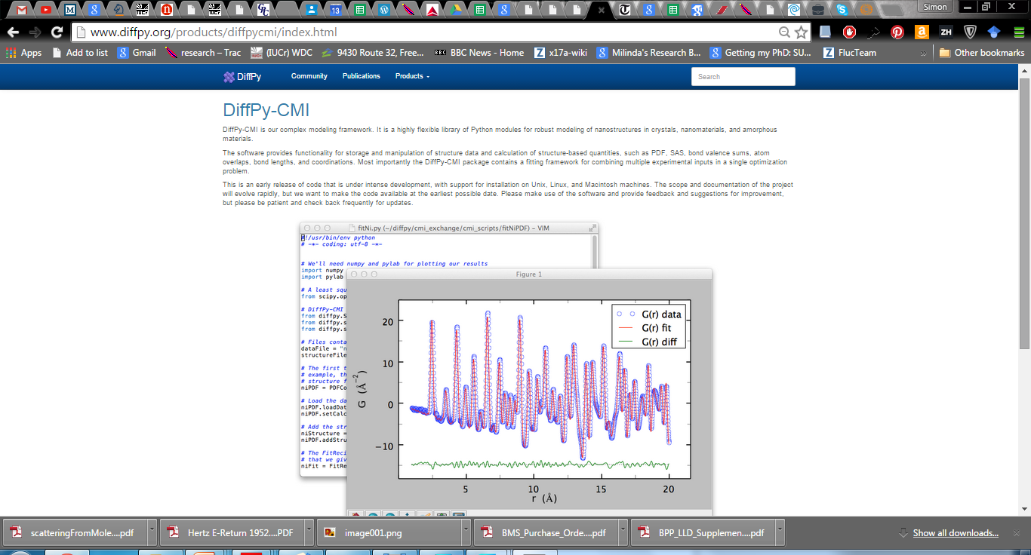



Diffpy-Complex Modeling Infrastructure: Diffpy-CMI
P. Juhás, C. L. Farrow, X. Yang, K. R. Knox and S. J. L. Billinge, Acta Crystallogr. A, (2015).

Slide 32


Slide 33


Slide 34

Diffpy project (BNL LDRD) Complex Modeling infrastructure: Diffpy-CMI
Official release of Diffpy-CMI v0.1
www.diffpy.org

Slide 35
Nanomaterials

Slide 36





Quantum Dot solar cells

Slide 37


CdSe quantum dots
RAPDF experiments at APS, Sector 6
Work of grad student Ahmad Masadeh
Masadeh, SJB et al. PRB 76, 115413 (2007)

Slide 38



Structure of the CdSe core
Wurtzite structure
Zinc blende structure

Slide 39


Masadeh, SJB et al. PRB 76, 115413 (2007)
Thanks to Reinhard Neder for help with stacking fault models

Slide 40



Size of the structural core
Masadeh, SJB et al. PRB 76, 115413 (2007)
Also see Shamoto paper, JAC 2007

Slide 41


White Light Nanoparticles
Xiaohao Yang, Masadeh, McBride, Bozin, Rosenthal and SJLB, Phys. Chem. Chem. Phys. 15, 8480-8486 (2013)

Slide 42




Zr/Sn phenyl phosphate, unconventional MOFs
Clearfield, A. Dalton Trans. 2008, 44, 6089-6102.
Collaboration with the group of Abe Clearfield, Texas A&M
Work of Chenyang Shi and Rita Silbernagel

Slide 43


The Challenge
Top, crystalline ZrP
Bottom, the phenyl phosphates
How to do structure solution from these data?

Slide 44


Try ZrP structures on H-Zr sample, PDFgui
Use PDFgui to fit 3D crystal structures from the literature (as indicated)
Fits do well up to ~7Å but less well beyond

Slide 45


Graphene modeling circa 1996
Poor person’s modeling of turbostratic disorder
Crystal structure of graphite in PDFFIT doesn’t fit will (top)
Enlarge ADPs along the c-axis by factor 10 to destroy all inter-layer correlations in the model
Fits the disordered carbon data well (bottom)
Kane, SJLB et al Chem Mater 8, 2159 (1996)
This won’t work here:

Slide 46


Single slab modelling on H-Zr/Na-Zr
Debye equation calculator to the rescue: compute PDF from a single layer
Results in an excellent fit over the entire range

Slide 47
Single slab modelling on H-Zr/Na-Zr

Slide 48


Summary
Many of society’s toughest challenges require complex materials.
Complex materials characterization present some of our toughest experimental and theoretical challenges
PDF analysis gives powerful insights into how complex materials work by revealing local structure in great detail

Slide 49



Acknowledgements
A special thank you to all my current and former students and post-docs
Also my many wonderful collaborators, mentioned during the talk
Facilities:
APS, CHESS, NSLS (and people therein)
MLNSC, ISIS, IPNS (and people therein)
Funding: DOE-BES and NSF-DMR

Slide 50



Ab initio nanoparticle Structure Solution from X-ray PDF data
Example: C₆₀
60 atoms => n(n-1)/2 = 1770 pair-vectors
We know the lengths (not the directions) of ~18 unique distances
We have an imperfect measure of the multiplicities of those distances
We don’t have any symmetry information to help us
Is the problem well conditioned or ill conditioned?
Is there a unique solution?

Slide 51
Is there enough information for an ab-initio structure solution?
Example: C60
60 atoms => n(n-1)/2 = 1770 pair-vectors
We know the lengths (not the directions) of ~18 unique distances
We have an imperfect measure of the multiplicities of those distances
We don’t have any symmetry information to help us
Is the problem well conditioned or ill conditioned?
Is there a unique solution?

Slide 52


Illustration of cluster buildup
square-distances = [4×1, 2×sqrt(2)]
octahedron-distances = [12×1, 3×sqrt(2)]
minimized cost function:
Juhas, SJB et al., Nature 2006
52

Slide 53

ab-initio structure solution directly from PDF data

Slide 54


60 atoms ~64 atoms
C₆₀ Ultra-small CdSe NPs

Slide 55




Successology

Slide 56
Problem
Well posed problem:
Information in the PDF data
ILL POSED Problem!
Degrees of freedom in the model
Bits of information

Slide 57

Structure Solution

Slide 58







Complex Modeling Solution
c = a + ib – complex number mixes real and imaginary parts
m = e + it – complex modeling mixes experiment and theory in a coherent computational framework
Billinge and Levin, Science 2007

Slide 59
Amorphous and nanocrystalline organics
system of small molecules
Fingerprinting
phase quantification
modeling molecular systems

Slide 60



Fingerprinting example: what about amorphous a-form?
Lab XRD of a-CBZ
Lab XRD of CBZ-γ
Lab XRD of CBZ-β
Notes:
60

Slide 61


Total scattering PDFs
β
γ

Slide 62



Visual comparison of melt-quenched CBZ
(blue) Crystalline Carbamezapine-beta (Form III)
Plotted to emphasize intermediate-r range
Melt quenched Carbamezapine
Melt quenched Carbamezapine corrected for 4.5 nm nanoparticle size effects
Simon J. L. Billinge, Timur Dykhne, Pavol Juhás, Emil Božin, Ryan Taylor, Alastair J. Florence and Kenneth Shankland, CrystEngComm 12, 1366-1368 (2010).

Slide 63



Quantifying amorphous API contents in the presence of crystalline material
Collaboration with Matthew Johnson, Senior Investigator, GlaxoSmithKline, thanks for help from Marco di Michiel
These are the raw data from the crystalline form (green) and the ball-milled form (blue) of the API.
Data ID15, ESRF
The ball milled sample is assumed to amorphous
Note the apparent lack of signal beyond 7 A⁻¹
funding from GSK

Slide 64

Quantifying amorphous API contents in the presence of crystalline material
These are the same data as shown in the previous viewgraph but processed to the reduced structure function, F(Q).
crystalline form (green) and the ball-milled form (blue) of the API.
The important high-Q signal is now apparent up to and beyond 19 A⁻¹

Slide 65

Quantifying amorphous API contents in the presence of crystalline material
The PDFs from the data shown in the previous viewgraph
crystalline form (green) and the ball-milled form (blue) of the API.
There is a signal at high-r in the crystalline sample but not the amorphous.

Slide 66

The low-r (top) and high-r (bottom) regions of the PDF from a series of samples that are a mixture of crystalline and amorphous.
Note the different amplitudes for the high-r features indicating different proportions of crystalline material in the samples.
Plotted on top are PDF curves made from a linear combination of the amorphous and pure crystalline PDFs.
The mixing fraction is adjusted to give the best fit
Then the amorphous and crystalline components can be quantified.

Slide 67


Recrystallization from the amorphous state: Lactose
Lactose is a common excipient for pharmaceutical tableting
Commercially available in crystalline or amorphous forms
A-form can be prepared from α-Monohydrate crystals by spray-drying, melt quenching, and lyophilization
Maxwell W. Terban, Eugene Y. Cheung, Paul Krolikowski and Simon J. L. Billinge, Cryst. Growth Des. , Doi: http://pubs.acs.org/doi/full/10.1021/acs.cgd.5b01100 (2015)

Slide 68

Lactose
Raw data
F(Q)
TSPDF
Of A-form (red) and crystalline (blue) lactose
TSPDF data collected at X17A@NSLS

Slide 69









Time dependent studies
Various A-form samples aged at, 40°C/75% RH

Slide 70





Time dependent studies
How does the crystallinity grow in?

Slide 71





Solving structure of nanoparticles and molecular solids
Regular PDFgui fit gives peaks too sharp in high-r, too broad at low-r
With Dragica Prill, Martin Schmidt and Juhas,
Prill, Juhás, Schmidt and S.J.L.B., J. Appl. Crystallogr. 48, 171-178 (2015)

Slide 72

Refinement of molecular PDFs
Workaround using DSE + RSC
Calculate molecule PDF using DSE (a)
Calculate crystal structure using RSC (b)
Calculate molecule using DSE but with crystal structure ADPs (c)
Determine inter-molecular correlation from (b)-(c)
Add (a) and (d) to get full pattern (e)

Slide 73

Result is excellent fit over whole range
Dragica Prill, Pavol Juhás, Martin U. Schmidt and SJLB J. Appl. Crystallogr. 48, 171-178 (2015)

Slide 74




Update: Structure solution of molecular materials now possible
pyobjcryst wraps functionality from ObjCryst++ (Favre-Nicolin and Cerny)
Rigid body constraints and quaternions to describe spatial orientations of molecules
Napthalene, P1, Z=2
Blue is single crystal structure, red is PDF derived structure
Dragica Prill, Pavol Juhás, S. J. L. Billinge and Martin U. Schmidt, Acta Crystallogr. A 72, 62-72 (2016)

Slide 75



Thin film PDF at normal incidence
Jensen, Iversen, Johnson, Dooryhee SJLB et al. IUCrJ 2015

Slide 76




Spatially Resolve PDFs
Anton Kovyakh, Soham Banerjee, Chia Hao Liu

Slide 77


High throughput allows spatially resolved tomographic imaging
Experiments on ID15 at ESRF
Pt/PtO nanoparticle catalyst on a g-alumina support in a flow rig
Have a fully refinable PDF in every pixel of the image
Large particle size in a shell around the rim, small particle size and much lower density in the middle
=> Spatially resolved, time resolved nanostructure studies
S. D. M. Jacques, Di Michiel, SJLB et al. Nat. Commun. 4, 2536 (2013)

Slide 78


Batteries
10,000 2D datasets per image, 30 mins per image
~10Tb/day
Jensen, Corr, Di Michiel, SJLB et al., J. Electrochem. Soc. (2015)

Slide 79


mPDF: PDF of short-range magnetic correlations
Benjamin A. Frandsen, Xiaohao Yang and Simon J.L. Billinge, Acta Crystallogr. A 70, 3-11 (2014).

Slide 80

MnO
Top: Blue: measured nPDF signal
Red (top) calculated structural PDF
Btm: Blue: difference between
nPDFsignal and calculated
structural PDF
Red: calculated mPDF for AF MnO
Benjamin A. Frandsen, M. Brunelli, K. Page, Y. J. Uemura, Julie B. Staunton, SJLB, arXiv:1512.06270.
Frandsen, SJLB, Acta Crystallogr. A 71, 325-334 (2015)

Slide 81

Summary

Slide 82

2015
brylcreem
Organic cotton
After 100 years of materials revolution…
Hipster
Organic leather
Organic canvas

